Slide 1

DEEP RESCUE
AI-Enhanced Disaster Response (AI) - DSS

Slide 2

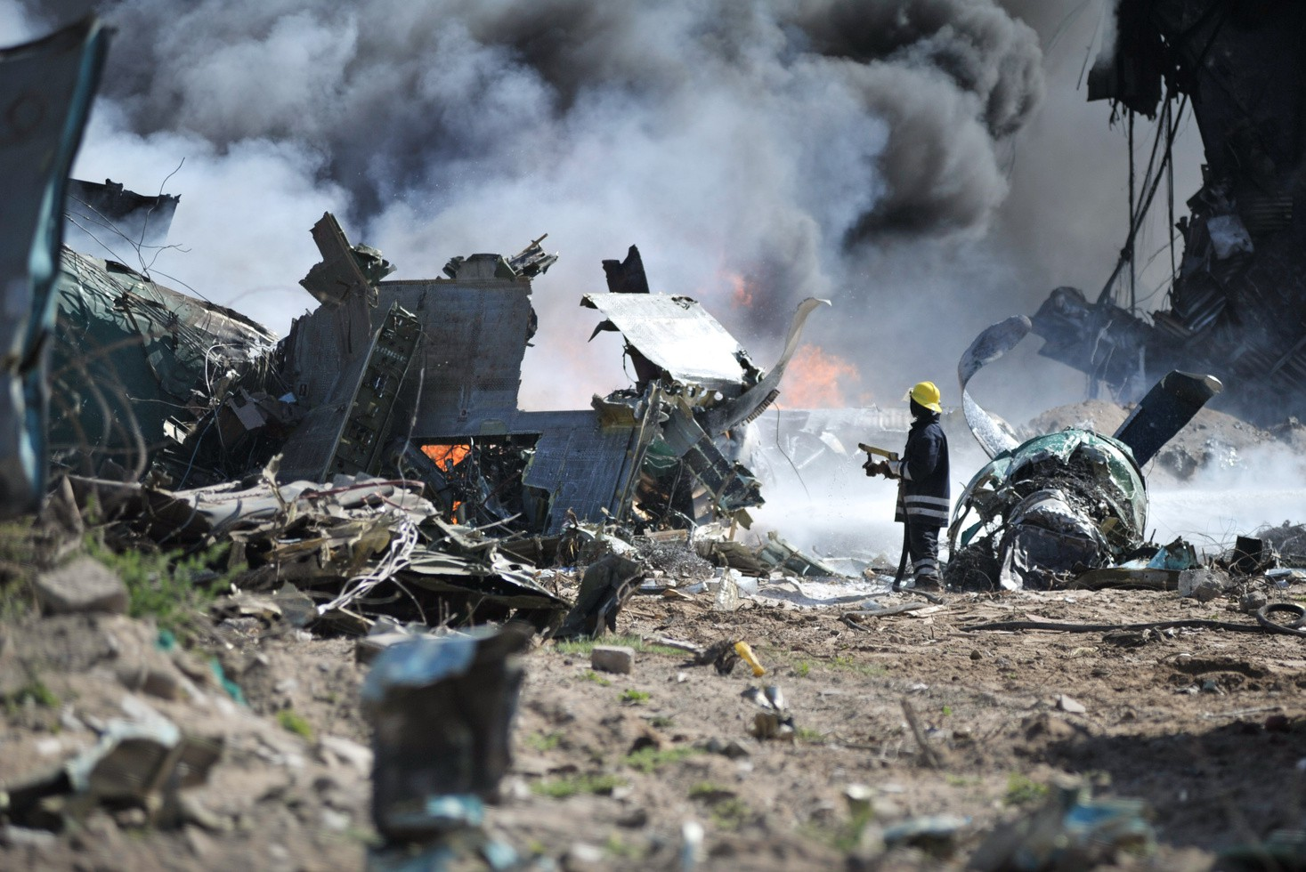
Disaster causes widespread economic material,human and infrastructure damage.
In the fiscal year 2023, over 2,100 lives were lost due to extreme natural events such as floods and heavy rains.
In some instances, government
response may be delayed or
inadequate, leading to preventable
fatalities. For example, during the 2025
Kumbh Mela stampede in Prayagraj,
administrative mismanagement was cited as a contributing factor to the tragedy.

Slide 3
MAJOR CHALLENGES IN DISASTER RESPONSE
INTERNET CONNECTIVITY
Communication breakdown and disconnection due to disaster.
DETECTION
Tardy identification of disasters cause fatalities and economic damages.
LOCALIZATION
It is very time consuming for rescue teams to locate victims and help them.

Slide 4

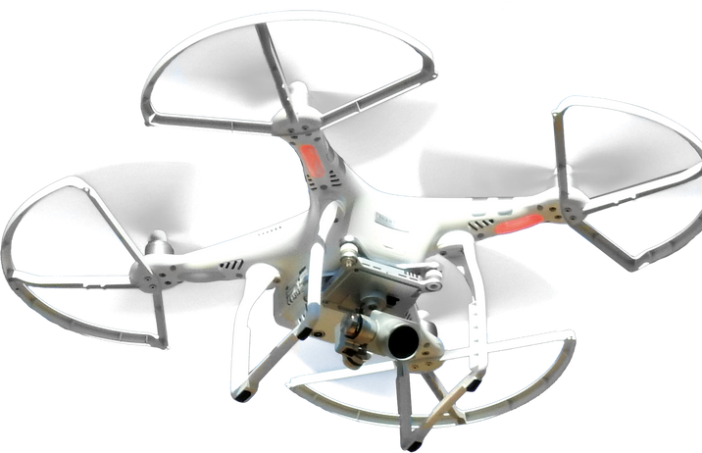
SOLUTION...
Our DEEPRESCUE- AI system analyzes satellite and aerial images, helping to pinpoint affected areas, evaluate damage, and locate survivors in disaster-hit regions.
It integrates real-time data with GIS mapping to support first responders and relief teams.
Automated Damage Assessment using AI-powered image classification (CNNs).
Survivor Detection using thermal imaging and motion tracking.
Real-Time Disaster Mapping with roadblock identification and safe route suggestions.
Decision Support System (DSS) to prioritize high-risk zones. AI-Powered Predictive Analysis for early warning systems, enabling authorities to take preventive measures before disasters escalate.

Slide 5

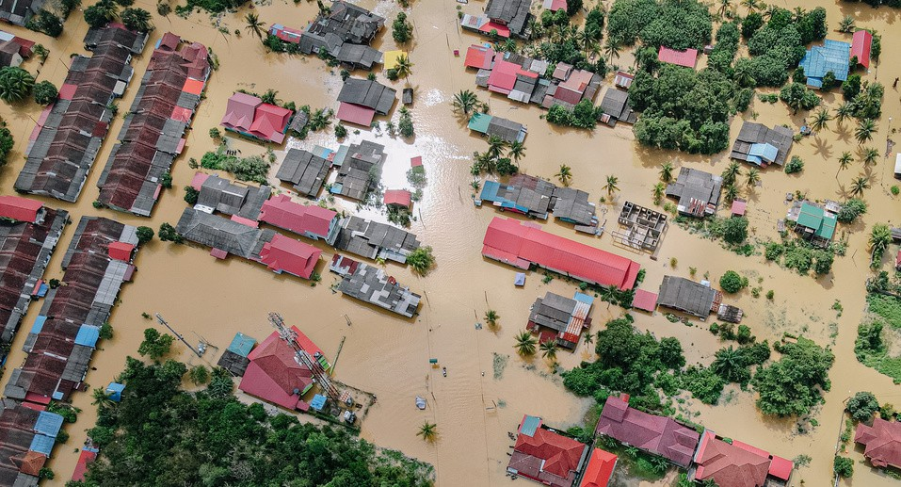

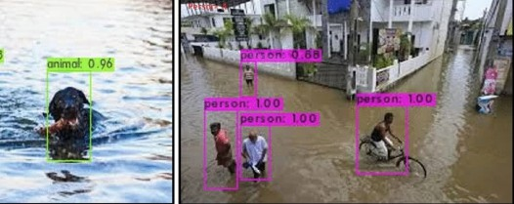
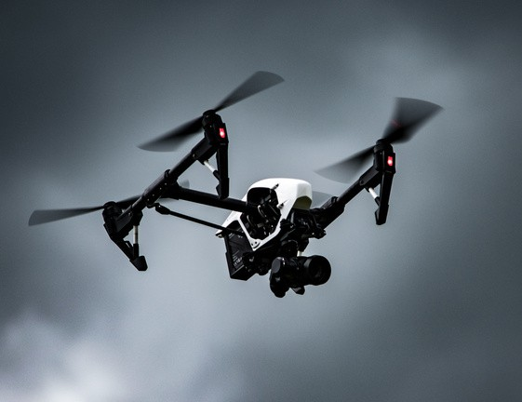
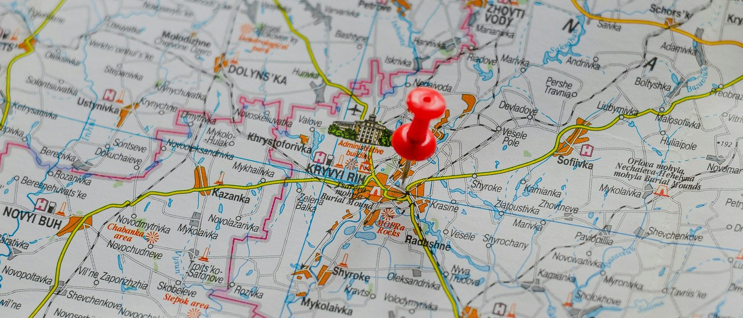
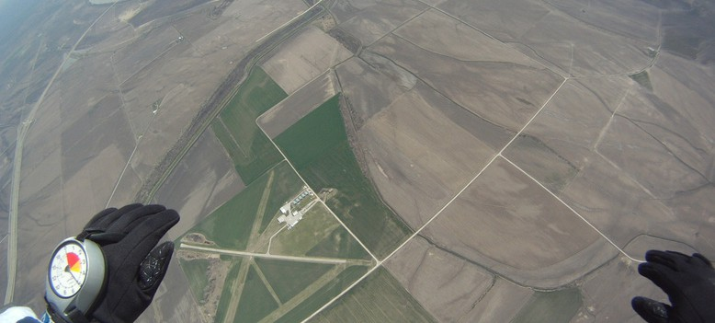
Solution model..
Disaster imagery
Drones
DEEPRESCUE System
GPS Coordinate
Height information

Slide 6


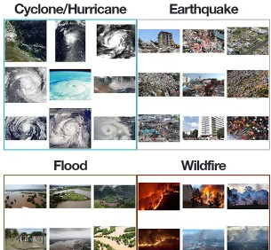
TECH STACKS ....
Data Sources: Sentinel-2, Landsat-8, OpenAerialMap.
AI/ML Models: CNN for damage assessment, YOLOv5 for object detection, FLIR thermal imaging for survivor tracking.
GIS Integration: Google Maps API Database: Firebase (for real-time data storage).
THANK YOU..

